Slide 1
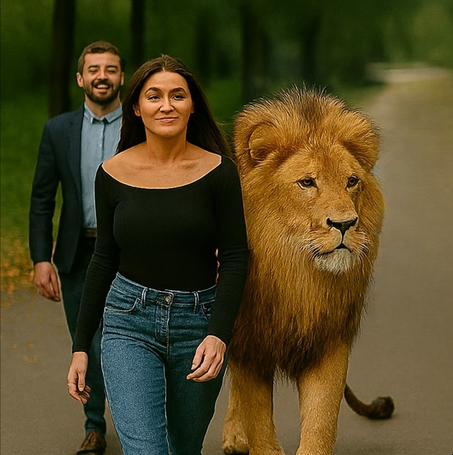
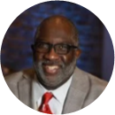
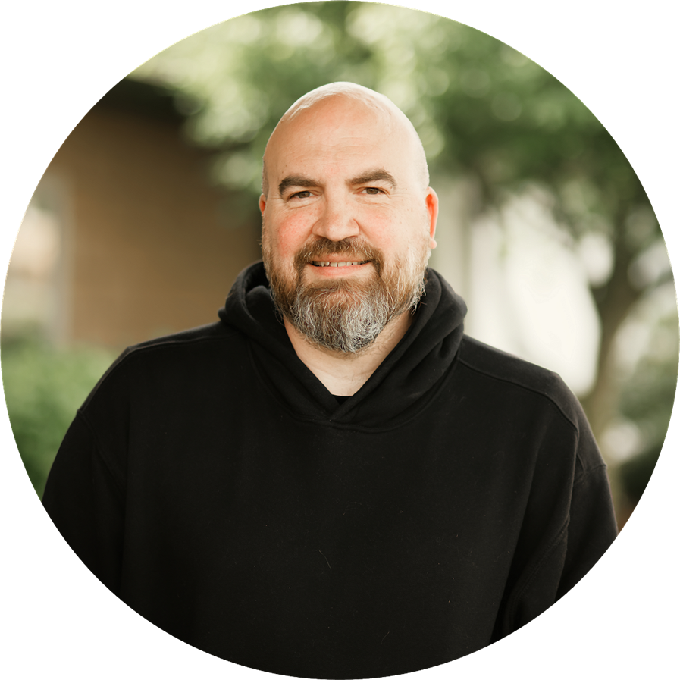
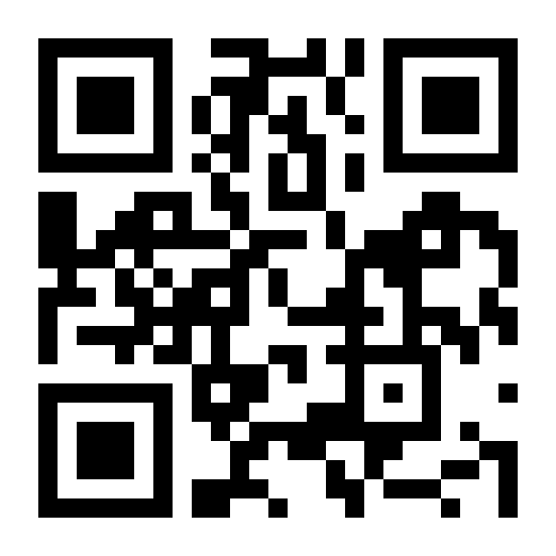
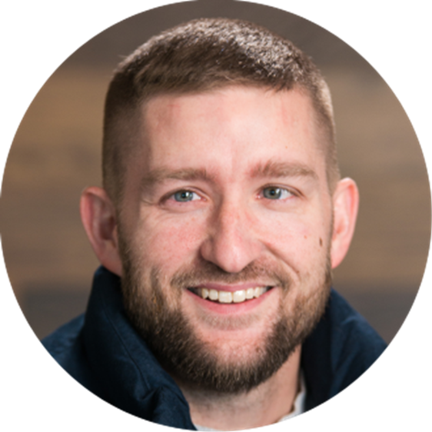
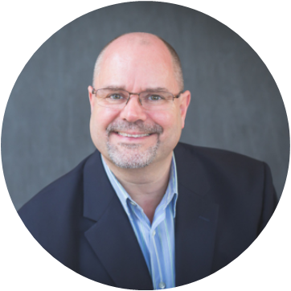
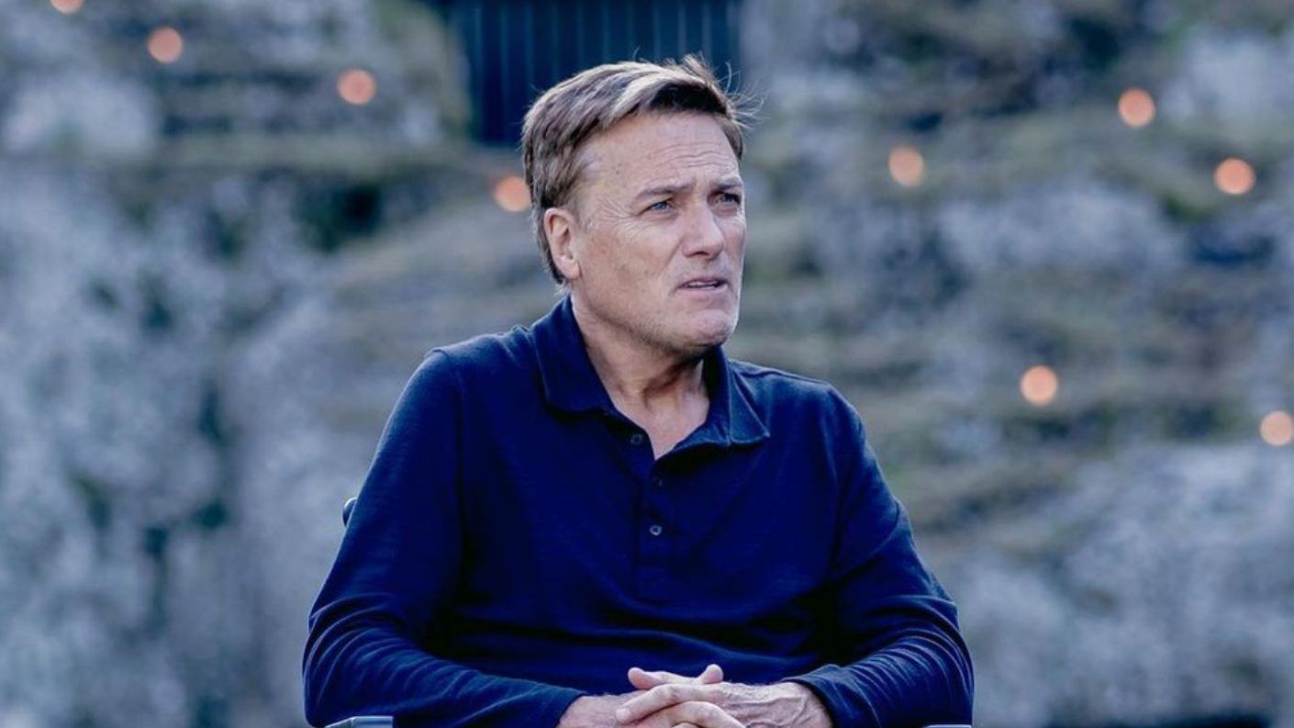

DARE TO BE BOLD
A Morning of Teaching with
May 23, 2026
9:00am - 3:00pm
Covelli Centre
229 East Front Street
Youngstown, Ohio
Bishop Timothy Clark
Christopher Holm
It’s Not just for men !
Billy Hartwig
David Kohout
An afternoon of
music with
Michael W. Smith
in a FREE concert
Starting at 1:00 pm
Get Tickets at
www.mensrally.org

Slide 2






Saturday
May 23rd

Slide 3
